Slide 1

Group HR Report Q2 FY25
23rd July 2025
Berna Frances Arinaitwe
Ag. GCHRO

Slide 2
Table of Contents
HR Q2 FY25 –Summary Report–(Group Headcounts, MPC/BTO Ratio, Attrition).
Key HR highlights- Recruitments, Performance Management, Disciplinary, L&D, Staff Engagements.
Project Red Sea-implementation update
Request to the Board

Slide 3
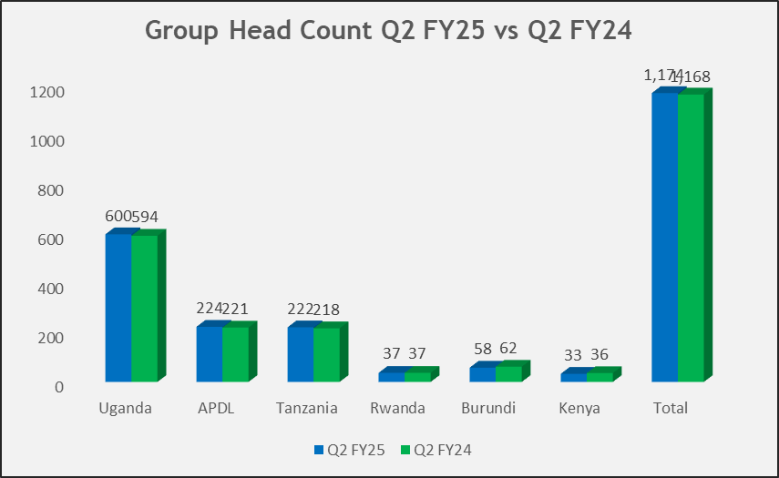
1. Group Headcount – Q2 FY25
Total Ave. Group Head count as at end of Q2 FY25 was 1,173 direct employees compared to 1,168 in Q2 FY24.
With all indirect employees (Casuals, Outsourced Security, and Principals) the total Ave. Head count for Q2 FY25 was 2,140 vs 2,114 in Q2 FY24.
Head count has grown by 0.5% compared to 0.95% in the previous year indicating good control on payroll costs. This is also the lowest in the last 4 years
Slight (1%) decline in gender diversity from 26% female direct employees to 25% in Q2 FY25 . With all Headcounts (direct & indirect), the gender split is 30% female and 70% male.
Maintained a staffing level of 10% expatriates
Detailed manpower Headcount is attached as Appendix 1.

Slide 4
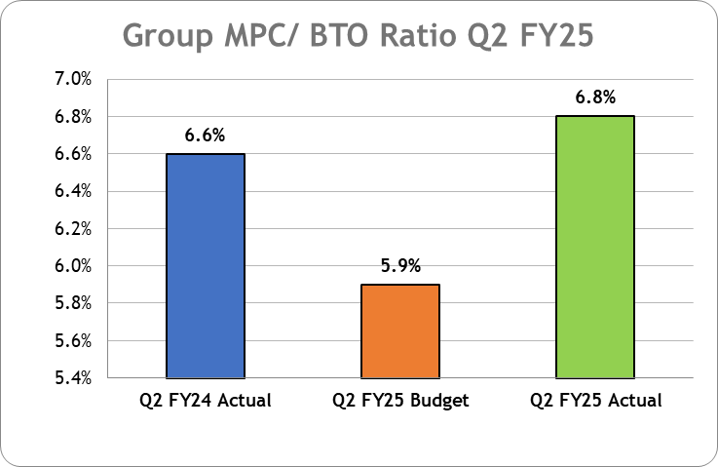
1.1. MPC/BTO ratio and Attrition
MPC/BTO ratio for Q2 FY25 at 6.8% compared to 6.6% last year and above budget of 5.9%. This is attributed to the payouts made to staff that exited through Red Sea and the Group performance in the last quarter.
Business Unit | Q2 FY24 | Q2 FY25 | Variance
Uganda | 1.7% | 0.8% | -0.9%
APDL | 1.8% | 1.8% | 0.0%
Tanzania | 0.5% | 0.4% | -0.1%
Rwanda | 2.7% | 5.5% | 2.8%
Burundi | 1.6% | 0.0% | -1.6%
Kenya | 5.6% | 0.0% | -5.6%
Group | 2.3% | 1.4% | -0.9%
Group Q2 YTD attrition was 1.4% compared to 2.3% in Q2 FY24. There is significant reduction in turnover across the Group indicating stability.
Group attrition is still below the targeted levels of not more than 6%. A list of regrettable exits has been attached to this report as appendix 2.
Notes:
Rwanda Turnover always looks high because of the base. In actual sense, they only lost two(2) staff

Slide 5
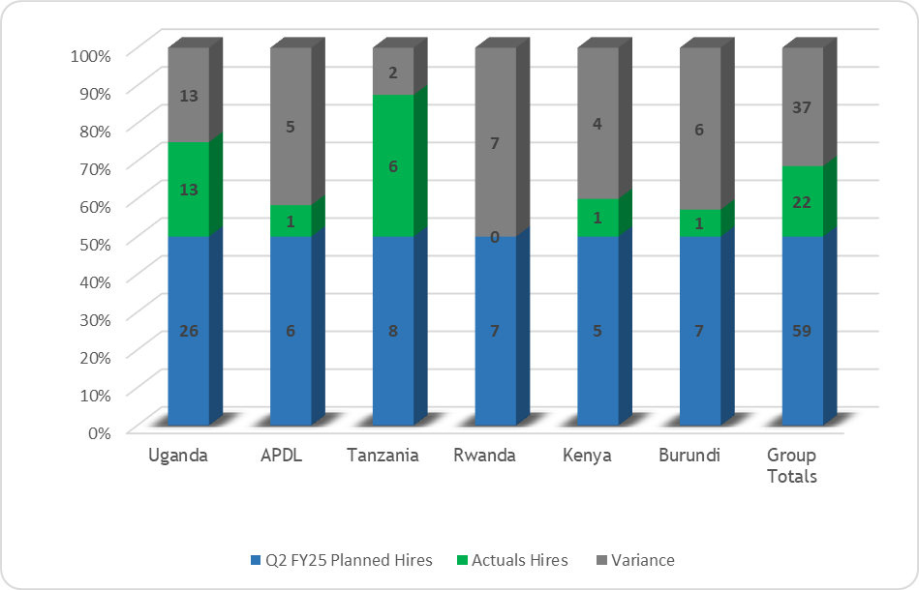
2. Group Recruitments and promotions
A total of 97 staff were recruited across the Group in Q2 FY25.
Out of the total 59 Q3 FY25 planned recruitments, 24 have been filled successfully representing 25% performance.
Additionally, 75 positions filled in Q2 were unplanned recruitments necessitated by exits YTD.
Recruitment for the pending positions is in advanced stages with most staff expected to report in Q3.
Four (4) employees were promoted to different positions in APL-Uganda and APDL
Ten (10) employees were transferred in APL Uganda to enhance performance.
The lists for recruitments Q2 FY25 have been attached to this report as appendix 3.
Notes:
Signed on three (3) New recruitment firms to support with sourcing of candidates
The delay in filling ABM positions is attributed to the low salary offer but this has since been revised.

Slide 6
2.1.Disciplinary Management
Revised the Disciplinary Code to align with the employment laws and new business developments across the Group.
Key Highlights of the new Disciplinary Code:
Introduced guiding principles/sentencing guidelines, new offences, separated previously merged offences with distinct essential elements, Offences increased from 15-30.
The New Disciplinary Code was communicated to staff and became effective on 1st July 2025.
Q2 FY25 Disciplinary Report
 | Group | Uganda | APDL | Tanzania | Rwanda | Burundi | Kenya
Group number of Cases | 32 | 11 | 6 | 15 | - | - | -
Pending/Open cases | 8 | 0 | 0 | 4 | 0 | 0 | 0
Closed cases | 24 | 11 | 6 | 11 | 0 | 0 | 0
The cases handled in Q2 involved 32 staff compared to 11 in FY24.
Of these, 22 cases were from Commercial, 4 from Supply Chain, 4 Quality and 2 from production departments
17 cases resulted into cessation of employment as listed in Appendix 4.

Slide 7
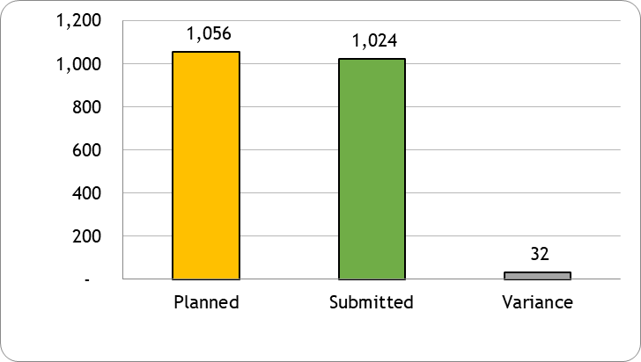
2.2 Group PM/KPIs-Setting and Midyear evaluation roll out
Group PMS/KPI setting closed at 97% compared to 93% in FY 24 as appendix 5 Mid year evaluation was rolled out on 17th July and is scheduled to end by 31st August 2025 The PM system continues to be updated to enhance process efficiency

Slide 8
2.3 Group Learning and Development
Focus in Q2 has been on functional trainings aimed at equipping staff with technical competencies
Soft Skills in the last quarter focused on Financial Literacy and OSHE
Q2 FY25 L&D Report
 | Group | Uganda | APDL | Tanzania | Rwanda | Burundi | Kenya
Group number of Programs | 44 | 3 | 28 | 7 | 2 | 1 | 3
Total Man hours | 2,300 | 1,118 | 591 | 325 | 9 | 12 | 245
Costs incurred | 2,334 | 1,043 | 0 | 522 | 0 | 0 | 769

Slide 9
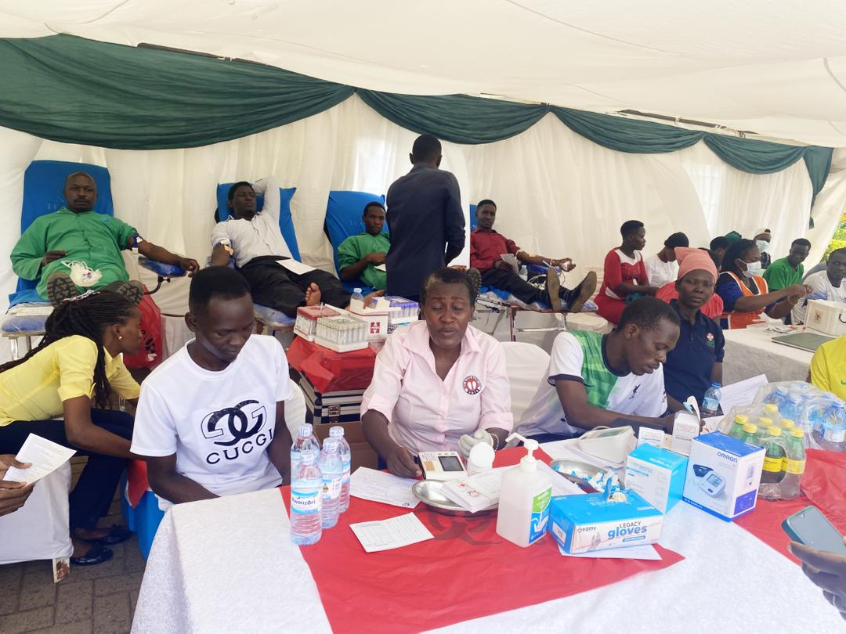
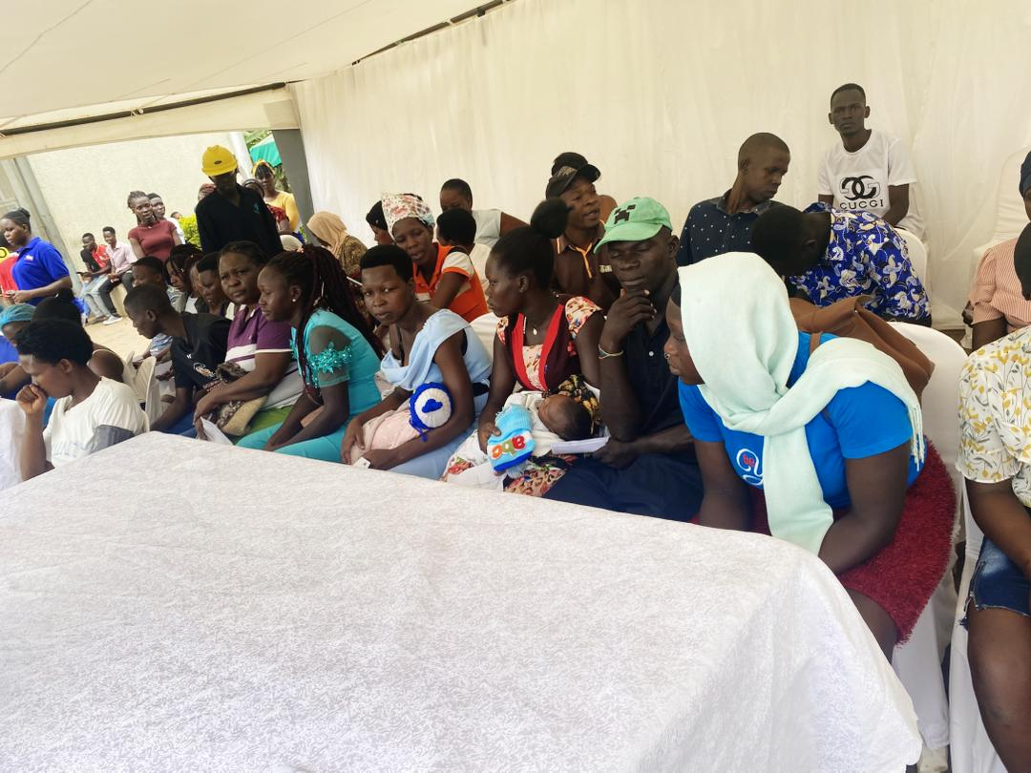
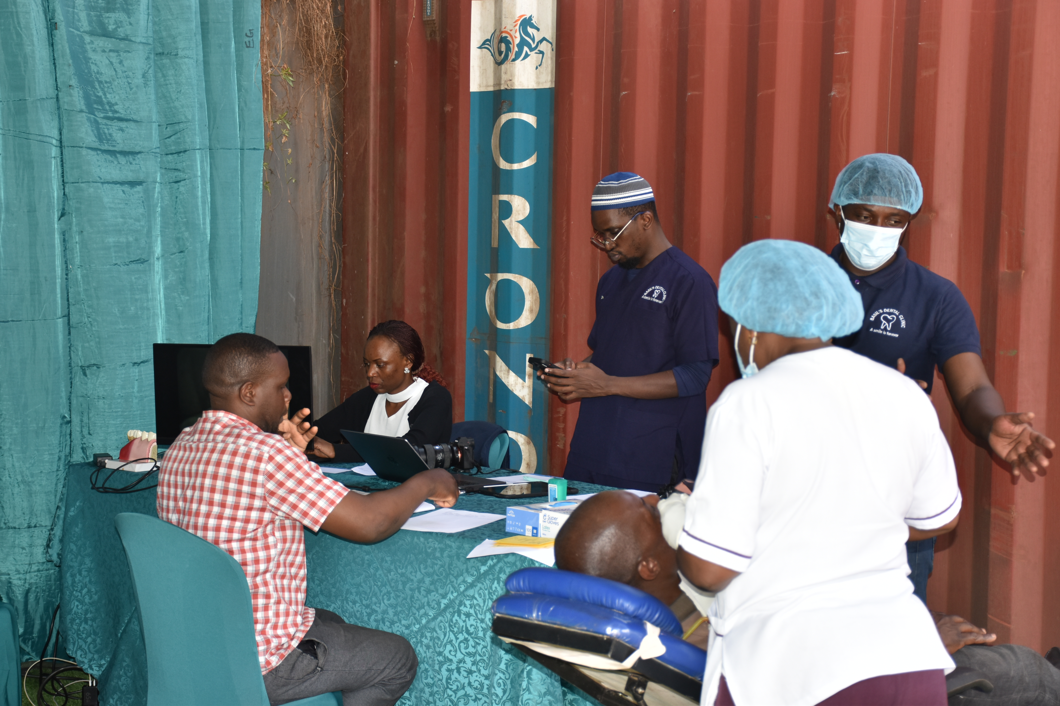
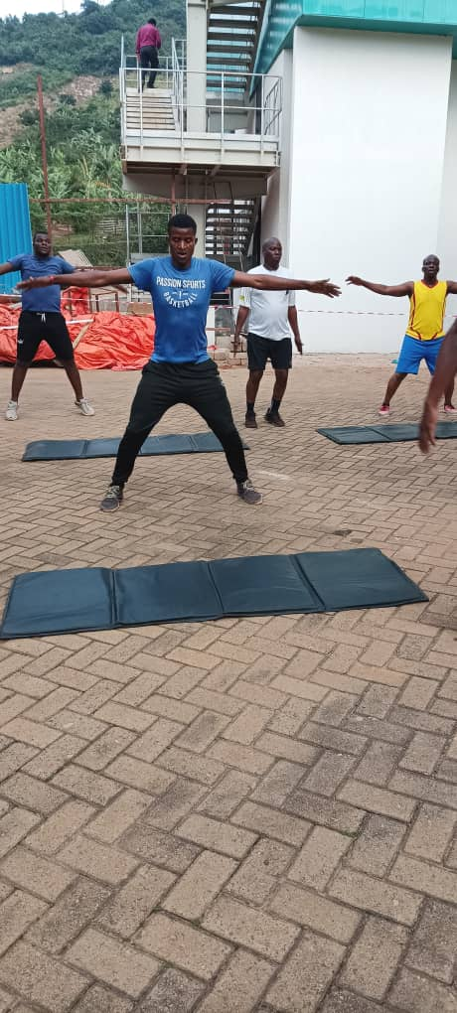
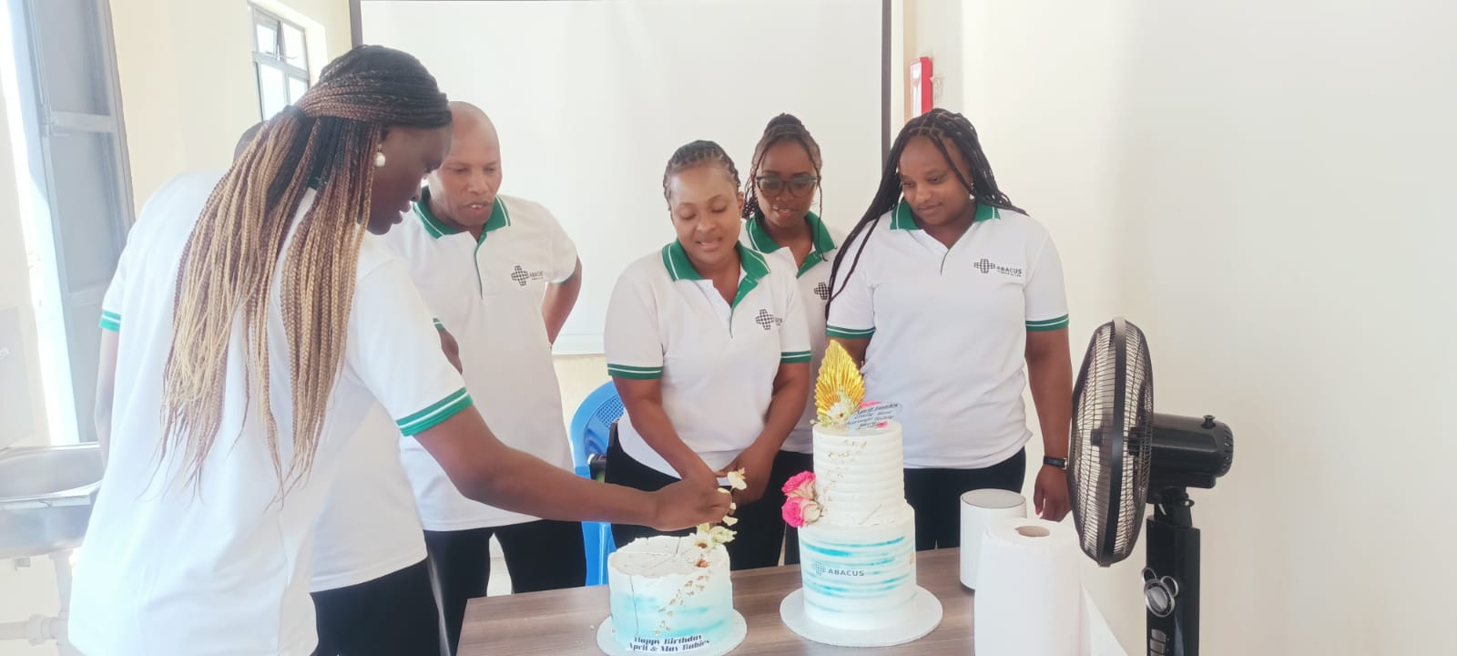
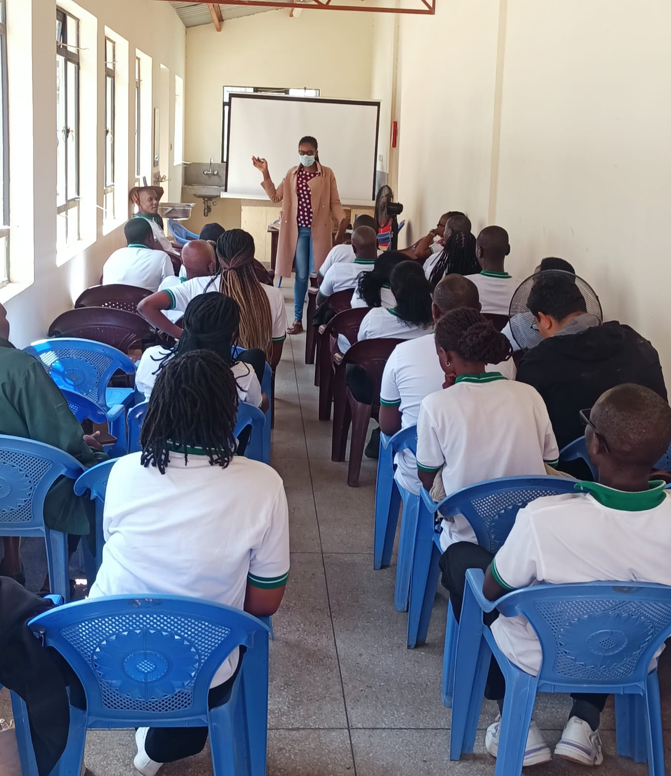
2.4. Group Wellness, EE and Learning & Development-Snap shots
Annual Medical camps were conducted across the Group in Uganda, APDL, Kenya, Rwanda in the month of June 2025
Physical fitness program continues at APDL
Notes:
Health Talks on Mental Health, Nutrition conducted for all staff across the group
Tests included: HIV, Blood Sugar, Hepatitis B, Blood donation drive- Open to staff and their families and the neighbouring communities
Partners: Jubilee Health, KCCA and Uganda Blood Bank

Slide 10
3. Status of implementation of Phase 2 of Project Red sea
The Board approved implementation of the Red Sea project as one of the cost management initiatives for FY 2025. Status: Phase 2 of the Red sea project involved exit of Seven (7) employees. Four (4) have been successfully exited Three (3) are pending completion of the recruitment process to identify suitable replacements due to the criticality of the positions. This is expected to be completed by end of Q3.

Slide 11
5. Request to the Board
Receive and approve the Group HR Q2 FY25 Report.

Slide 12
Thank You!

Slide 13
Appendix 1: Detailed Group Headcount Q2 FY25
 | Group |  | Uganda |  | APDL |  | Tanzania |  | Rwanda |  | Burundi |  | Kenya
 | Number | % | Number | % | Number | % | Number | % | Number | % | Number | % | Number | %
Overall Headcount | 2,140 | 100% | 950 | 44% | 760 | 36% | 255 | 12% | 71 | 3% | 63 | 3% | 42 | 2%
Direct Staff | 1,173 | 55% | 600 | 51% | 224 | 19% | 222 | 19% | 37 | 3% | 58 | 5% | 33 | 3%
Female | 293 | 25% | 134 | 22% | 46 | 20% | 65 | 29% | 14 | 39% | 16 | 28% | 18 | 54%
Male | 881 | 75% | 465 | 78% | 178 | 80% | 158 | 71% | 22 | 61% | 42 | 72% | 15 | 46%
Nationals | 1,055 | 90% | 517 | 86% | 213 | 95% | 207 | 93% | 33 | 90% | 53 | 91% | 32 | 97%
Expatriates | 119 | 10% | 82 | 14% | 11 | 5% | 15 | 7% | 4 | 10% | 6 | 10% | 1 | 3%
Management | 255 | 22% | 122 | 20% | 57 | 26% | 42 | 19% | 11 | 30% | 16 | 28% | 7 | 21%
Female in Management | 46 | 18% | 21 | 17% | 9 | 15% | 7 | 18% | 3 | 27% | 4 | 25% | 2 | 29%
Below 40 years of age | 927 | 79% | 462 | 77% | 178 | 80% | 182 | 82% | 32 | 86% | 47 | 81% | 26 | 79%
Atleast 40 years of age | 246 | 21% | 138 | 23% | 45 | 20% | 40 | 18% | 5 | 14% | 11 | 19% | 7 | 21%
Less than 5 years with Abacus | 693 | 59% | 367 | 61% | 99 | 44% | 145 | 65% | 28 | 76% | 29 | 50% | 25 | 76%
At least 5 years with Abacus | 480 | 41% | 232 | 39% | 125 | 56% | 77 | 35% | 9 | 24% | 29 | 50% | 8 | 24%
Total New hires | 42 | 3% | 19 | 100% | 11 | 100% | 8 | 100% | 3 | 100% | 1 | 100% | 1 | 100%
New hires at EXCO | - | 0% | - | 0% | - | - | - | - | - | - | - | - | - | -
New hires at EXCO - 1&2 | 9 | 1% | 9 | 48% | - | 0% | - | 0% | - | - | - | 0% | - | 0%
New hires at Other Levels | 33 | 3% | 10 | 52% | 11 | 100% | 8 | 100% | 3 | 100% | 1 | 100% | 1 | 100%
Total Exits | 24 | 2.0% | 9 | 1.5% | 4 | 1.9% | 6 | 2.5% | 2 | 3.8% | 1 | 0.8% | 3 | 8.9%
Exits at EXCO | 0 | 0.0% | 0 | 0.1% | - | 0.0% | - | 0.0% | - | 0.0% | - | 0.0% | - | 0.0%
Exits at EXCO - 1&2 | 1 | 0.1% | 1 | 0.1% | - | 0.0% | - | 0.0% | - | 0.0% | - | 0.0% | - | 0.0%
Exits at Other Levels | 23 | 1.9% | 8 | 1.4% | 4 | 1.9% | 6 | 2.5% | 2 | 3.8% | 1 | 0.8% | 3 | 8.9%
Total Internal Movements | 15 |  | 6 | 0.0% | 1 | 0.0% | 7 | 0.0% | - | 0.0% | - | 0.0% | - | 0.0%
Promotions | 8 |  | 1 |  | 1 |  | 6 |  | - |  | - |  | -
Transfers | 6 |  | 5 |  | 0 |  | 1 |  | - |  | - |  | -
Principals | 388 | 32% | 308 | 79% | - | - | 32 | 8.3% | 34 | 11.1% | 5 | 1.2% | 9 | 2.2%
Female | 99 | 25% | 69 | 23% | - | - | 10 | 32% | 14 | 41% | 1 | 21% | 4 | -
Male | 289 | 75% | 239 | 77% | - | - | 22 | 68% | 20 | 59% | 4 | 79% | 5 | -
Casuals/Contractors | 579 | 27% | 42 | 7% | 537 | 93% | - | - | - | 0% | - | - | - | -
Female | 243 | 42% | 6 | 14% | 237 | 44% | - | - | - | - | - | - | - | -
Male | 336 | 58% | 36 | 86% | 300 | 56% | - | - | - | - | - | - | - | -

Slide 14
Appendix 2: Group Regrettable Exits Q2 FY25 YTD
Notes:
Average Years of service for regrettable exits is 5.7 years

Slide 15
Appendix 3: Group Recruitments YTD
Summary Planned/Budgeted Recruitments as of June FY25
Business Unit | Planned Hires | Actual Hires | Variance | Pending | Justifications/ Comments
Uganda | 26 | 13 | 13 | 12 positions: 1 field sales rep, 6 Medical Reps, 1 sales Manager/Debt collections, 4 Sales Reps (order booking-branch) 1 position in Supply chain; 1 Logistics officer | Focus was on filling the critical positions that fell vacant because of Red sea project
APDL | 6 | 1 | 5 | 5 positions: 1 dispatch clerk, 1 purchase assistant, 3 medical reps | Positions pushed to Q3 to be aligned with plant opening
Tanzania | 8 | 6 | 2 | 2 positions: 1 delivery driver the vehicle has not yet been bought, 1 RBDM on hold | Positions put on hold
Rwanda | 7 | 0 | 7 | 7 positions 1 Asst Sales Manager, 3 Delivery Associate, 1 Counter Sales and Accounts Assistant, 1 field sales rep, 1 Warehouse Assistant pushed to Q3 | Delayed recruitment but the process has commenced
Kenya | 5 | 1 | 4 | 4 positions 4 Medical Representatives pushed to Q3. | Positions pushed to Q3
Burundi | 7 | 1 | 6 | 6 positions: 1 sales rep, 5 medical reps | Delayed recruitment
Group | 59 | 22 | 37
Notes:
Although these positions were planned for Q2, focus was on the critical roles that fell vacant in Q1 & Q2 through voluntary exits and red sea project

Slide 16
Appendix 4: Disciplinary Schedule-Q2 FY25

Slide 17
Appendix 5: Group PMS/KPI Submission Compliance-Q2 FY25
PMS KPI 2025 SUBMISSION STATUS
Department | APL-Uganda | APDL | APL-Tanzania | APL-Kenya | APL-Burundi | APL-Rwanda | Total Submissions
Commercial | 370 | 15 | 147 | 15 | 41 | 23 | 611
Supply Chain Management | 67 | 13 | 47 | 9 | 5 | 5 | 146
Finance | 9 | 5 | 9 | 3 | 4 | 3 | 33
Administration | 2 | 11 | 0 | 0 | 0 | 0 | 13
Legal & Compliance | 2 | 0 | 0 | 0 | 0 | 0 | 2
Human Resources | 31 | 5 | 4 | 3 | 3 | 1 | 47
Production | 0 | 57 | 0 | 0 | 0 | 0 | 57
Regulatory Affairs | 4 | 0 | 3 | 1 | 3 | 1 | 12
Internal Audit | 8 | 0 | 3 | 0 | 1 | 0 | 12
Maintenance | 0 | 32 | 0 | 0 | 0 | 0 | 32
Information Technology | 5 | 2 | 3 | 0 | 0 | 0 | 10
Quality | 0 | 49 | 0 | 0 | 0 | 0 | 49
Total Submitted | 498 | 189 | 216 | 31 | 57 | 33 | 1024
Eligible Staff | 527 | 191 | 216 | 31 | 58 | 33 | 1056
Pending | 29 | 2 | 0 | 0 | 1 | 0 | 32
Submission Rate | 94% | 99% | 100% | 100% | 98% | 100% | 97%

